Slide 1
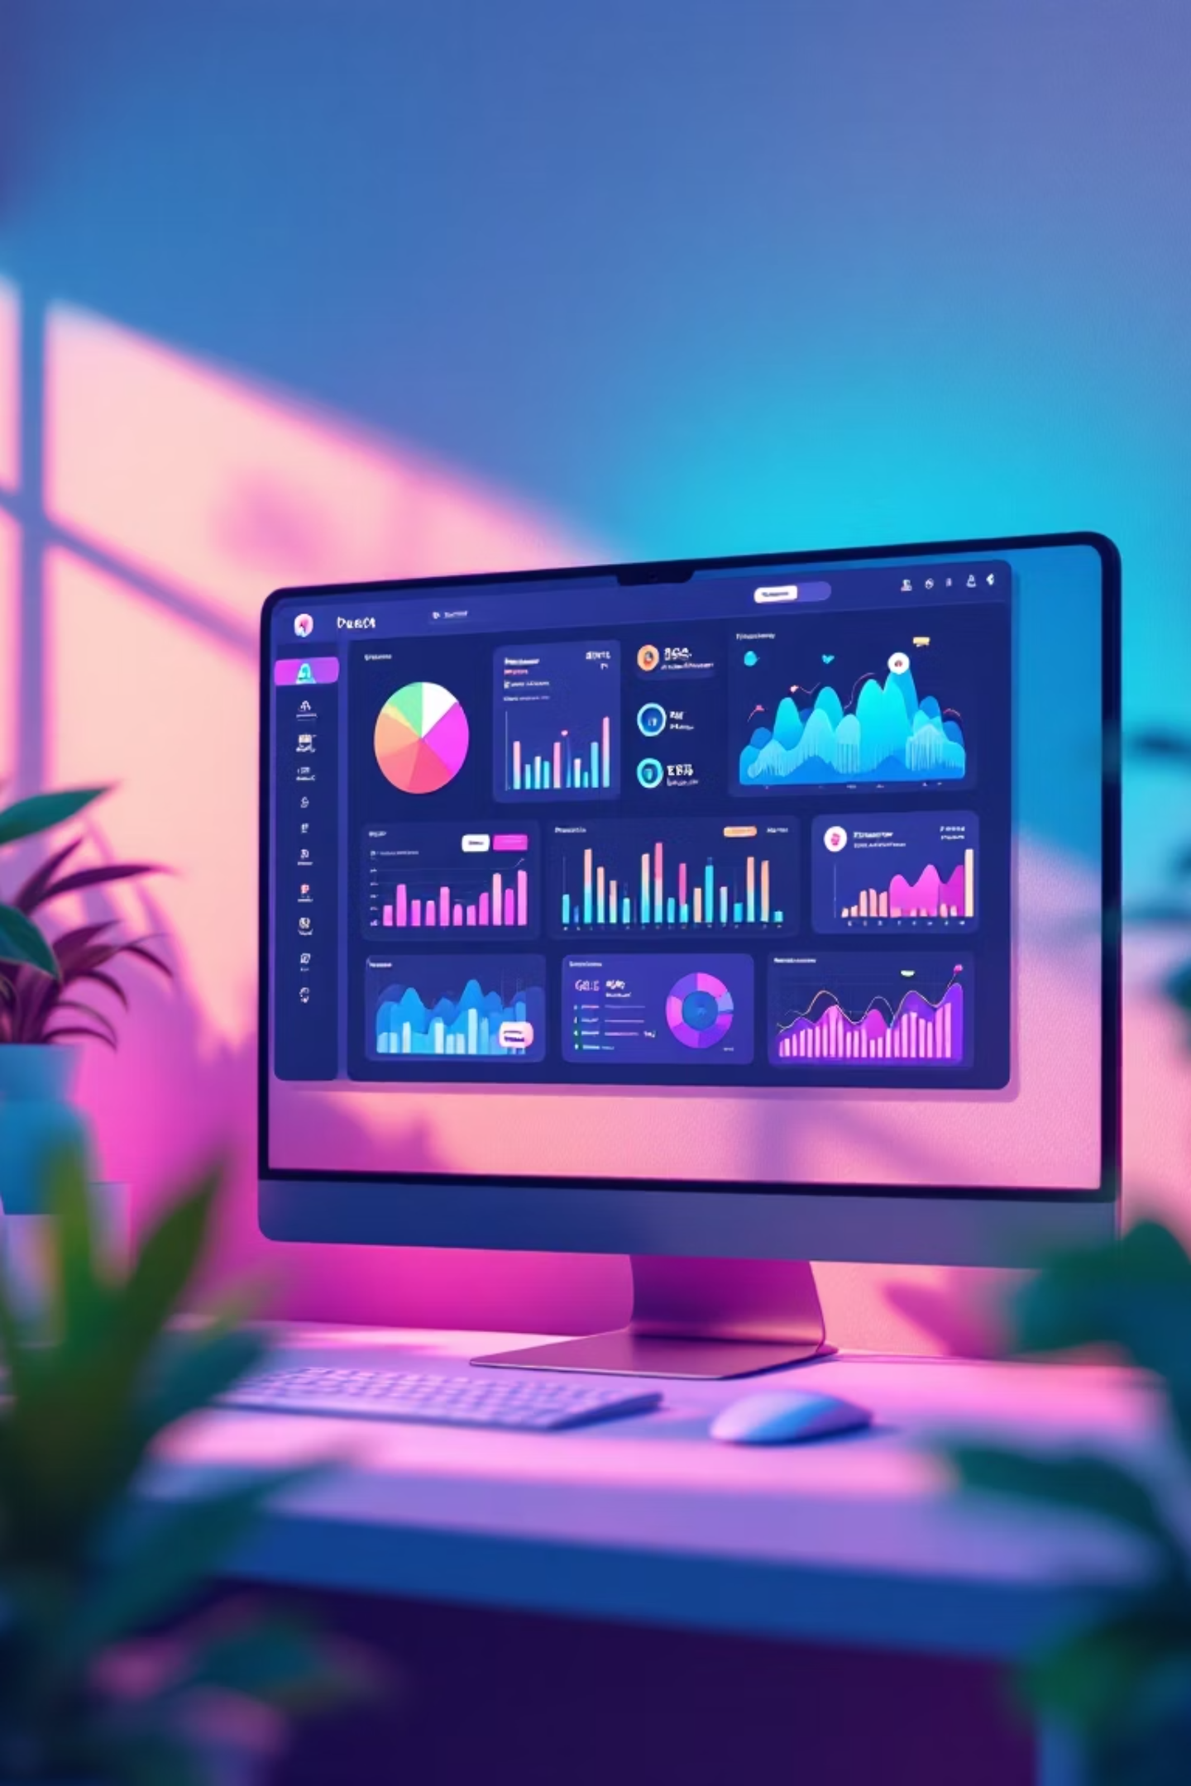

Transform Your Business With Our Comprehensive ERP System
Elevate your operations with our cutting-edge, Angular-based ERP system. Designed for modern enterprises, it seamlessly integrates essential functions including HR and Payroll for efficient workforce management, comprehensive Finance modules for precise accounting and reporting, and robust Sales tools to drive revenue and manage customer relationships. Streamline your processes and unlock new levels of productivity.

Slide 2

HR & Payroll Management: Streamline Your Workforce
Optimize your human resources and payroll operations with our comprehensive ERP module. From onboarding to payroll processing, ensure efficiency, accuracy, and compliance across your entire workforce management.
01
Employee Onboarding & Management
Seamlessly integrate new hires and manage employee data from a centralized system, ensuring all information is up-to-date.
02
Automated Time & Attendance
Track work hours, manage leave requests, and ensure accurate attendance records with automated systems to reduce manual effort.
03
Efficient Payroll Processing
Automate payroll calculations, deductions, and disbursements, ensuring timely and accurate payments for all employees.
04
Compliance & Reporting
Stay compliant with evolving labor laws and generate comprehensive reports for better strategic decision-making and audits.

Slide 3

Financial Management Made Simple
Our comprehensive finance module helps you streamline your financial operations, providing robust tools for accounting, budgeting, and insightful reporting. Gain clarity and control over your finances to drive strategic growth.
1. Core Accounting
Automate general ledger, accounts payable, and accounts receivable to maintain accurate financial records.
2. Budgeting & Forecasting
Create detailed budgets, perform variance analysis, and generate accurate financial forecasts for better planning.
3. Financial Reporting & Analytics
Generate customizable reports, analyze key performance indicators, and gain actionable insights into your business performance.

Slide 4
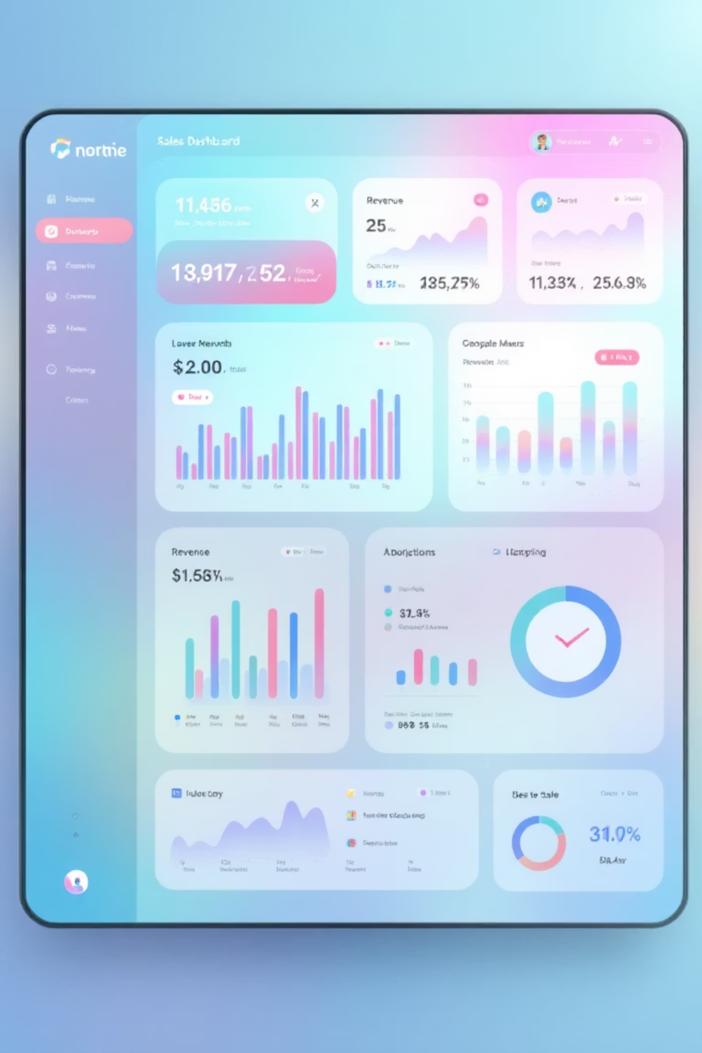
Boost Revenue With Intelligent Sales Management
Our intelligent Sales module empowers your team to optimize every stage of the sales cycle, from lead generation to deal closure. Streamline operations, gain deep customer insights, and drive significant revenue growth with powerful tools designed for modern sales teams.
Sales Tracking & Pipeline
Monitor sales activities in real-time, visualize your pipeline, and identify bottlenecks to accelerate deal velocity.
Customer Insights & Analytics
Leverage data-driven insights to understand customer behavior, predict trends, and tailor your sales approach.
Reporting & Forecasting
Generate comprehensive sales reports and accurate forecasts to make informed decisions and strategize for future growth.

Slide 5

Built With Angular: Modern, Fast & Scalable
Our ERP system is powered by Angular, a leading platform for building modern web applications. We chose Angular for its robust framework, enabling us to deliver exceptional performance, unparalleled scalability, and a truly responsive design across all devices. Its modern architecture ensures a secure, maintainable, and future-proof solution for your business.

Slide 6


Ready to Transform Your Business?
Harness the power of our modern ERP system to streamline operations, enhance efficiency, and drive growth. Built with cutting-edge technology, it's designed to propel your business forward. Connect with our team today to discover how we can tailor a solution to your unique needs.

